Slide 1
Full Stack .Net Training
Day 2 (SQL)
10:15 - 11:15 CT MON- FRI
everestuptech@gmail.com

Slide 2
SQL ( Structured Query Language)
SQL is a standard language for storing, manipulating and retrieving data in databases.
SQL Server is a relational database management system (RDBMS) by Microsoft.
SQL Server Management Studio (SSMS) is an integrated environment for managing any SQL infrastructure. Used to access, configure, manage, administer, and develop all components of SQL Server.
RDBMS is a type of database management system (DBMS) that stores data in a row-based table structure which connects related data elements.
Oracle, MySQL, Microsoft SQL Server, PostgreSQL

Slide 3
Type of Commands in SQL
DDL – Data Definition Language
DQL – Data Query Language
DML – Data Manipulation Language
DCL – Data Control Language
TCL – Transaction Control Language

Slide 4
DDL (Data Definition Language)
consists of the SQL commands that can be used to define the database schema.
create and modify the structure of database objects in the database.
DDL is a set of SQL commands used to create, modify, and delete database structures but not data.
CREATE: to create the database or its objects ( table, index, function, views, store procedure, and triggers).
DROP: to delete objects from the database.
ALTER: to alter the structure of the database.
TRUNCATE: to remove all records from a table, including all spaces allocated for the records are removed.

Slide 5
DQL – Data Query Language
DQL statements are used for performing queries on the data within schema objects.
SELECT: used to retrieve data from the database.

Slide 6
DML – Data Manipulation Language
To manipulate of data present in the database
INSERT: used to insert data into a table.
UPDATE: used to update existing data within a table.
DELETE: used to delete records from a database table.

Slide 7
DCL – Data Control Language
DCL includes commands such as GRANT and REVOKE which mainly deal with the rights, permissions, and other controls of the database system.
GRANT: This command gives users access privileges to the database.
REVOKE: This command withdraws the user’s access privileges given by using the GRANT command.

Slide 8
TCL (Transaction Control Language)
Transactions group a set of tasks into a single execution unit.
COMMIT
ROLLBACK

Slide 9
Hands On Example

Slide 10
Assignment
Create a table named "Employees" with the following columns:
"EmployeeID" of type INT and set it as the primary key.
"FirstName" of type VARCHAR(50).
"LastName" of type VARCHAR(50).
"DateOfBirth" of type DATE.
"Salary" of type DECIMAL(10, 2).

Slide 11
Assignment
2. Write query to drop "Salary"column from table "Employees"
3. Write query to Insert at least two rows into table "Employees"
4. Write query to update one row.

Slide 12
KEYS
Unique Key : Uniquely identifies each elements in a table.
Primary Key : A primary key is used as a unique identifier to quickly parse data within the table.A table cannot have more than one primary key.
Foreign Key: constraint is used to prevent actions that would destroy links between tables. It is a field (or collection of fields) in one table, that refers to the PRIMARY KEY in another table.

Slide 13
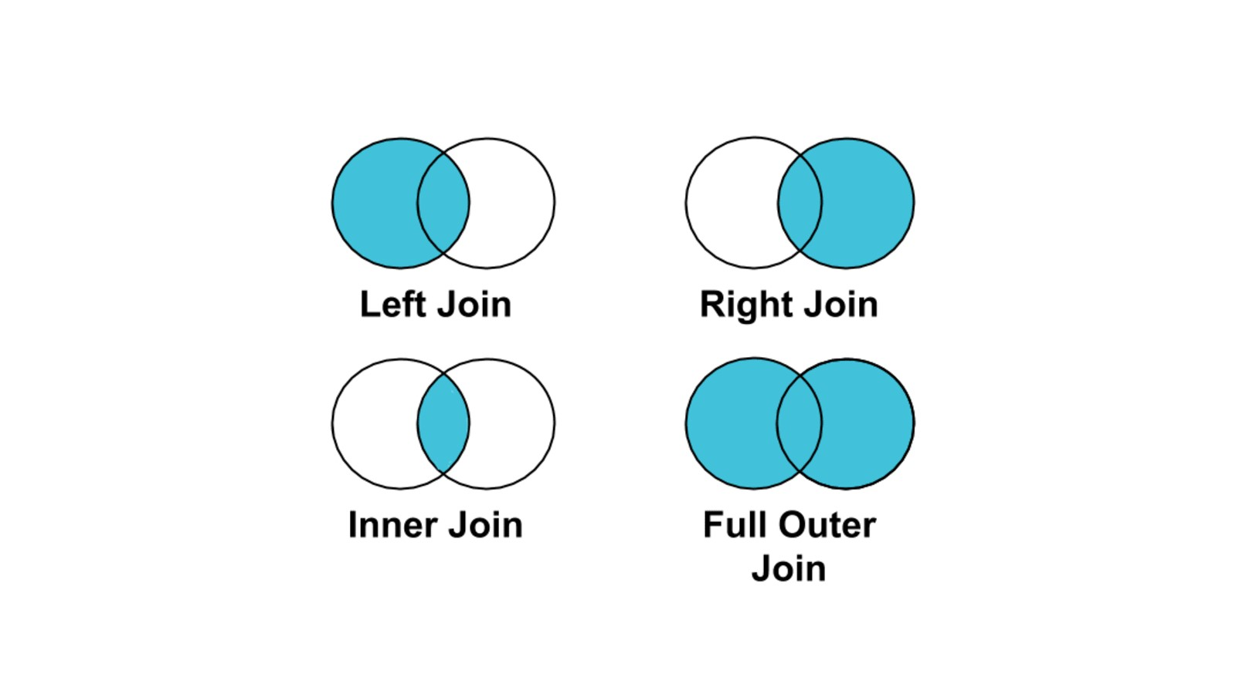
SQL JOINS
Inner Join
Left Join
Right Join
Full Outer Join
Cross Join
Self Join

Slide 14
Hands on Example

